Slide 1
Python files
Non volatile storage

Slide 2
2020 – assessment 1 discussion and feedback
Chit chat about assessment 1

Slide 3
Storing data
RAM is volatile
When the power is turned off, the data is lost
Files are non-volatile, they remain when the power is turned off

Slide 4
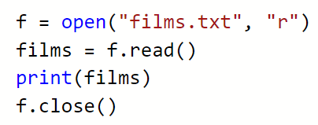
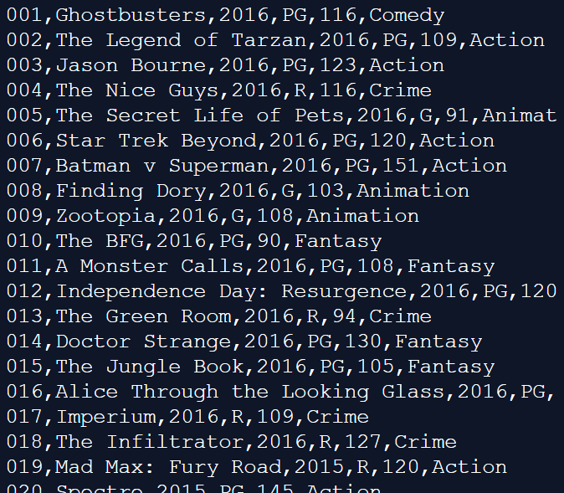
Where do you think this file is located?
r – read (why?)
w – write
rw – read & write

Slide 5
Readline()
We will expand the code by adding the readline() statement
This method will read one line from the file
The line is assigned to a variable
We can inspect each line and only print the data we want from the file

Slide 6
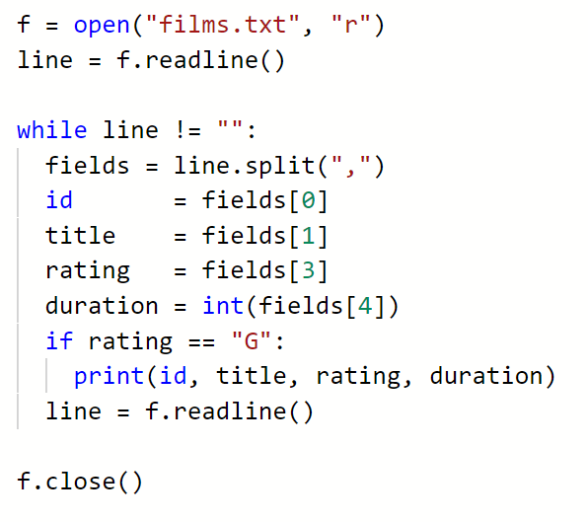
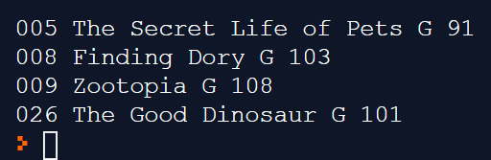

Slide 7
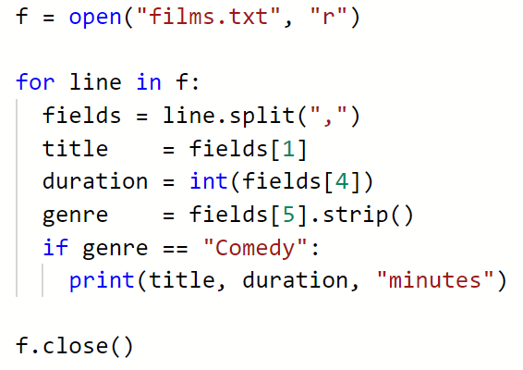
Using a for loop

Slide 8

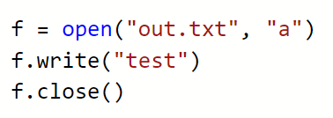
Writing to a file
New files can be written to a file by opening in write mode:
This will create a new file, if a file named out.txt already exists, it will be overwritten
It is also possible to open a file in append mode:
This will create a new file if none exists, or open an existing file and insert the line at the end

Slide 9
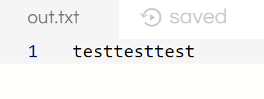

Slide 10
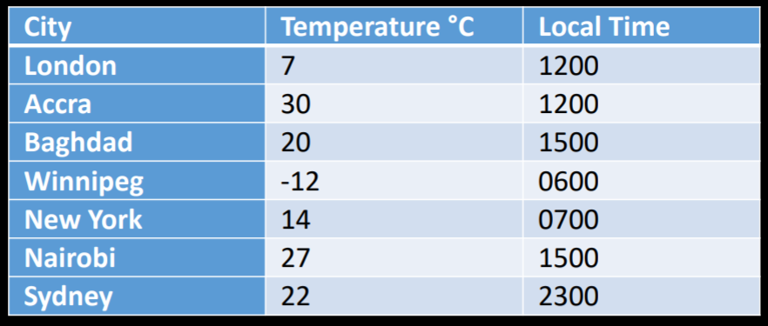
Example
In this example, a file is created to hold data showing the local time and he temperature °C of several cities around the world on a particular day in February.

Slide 11
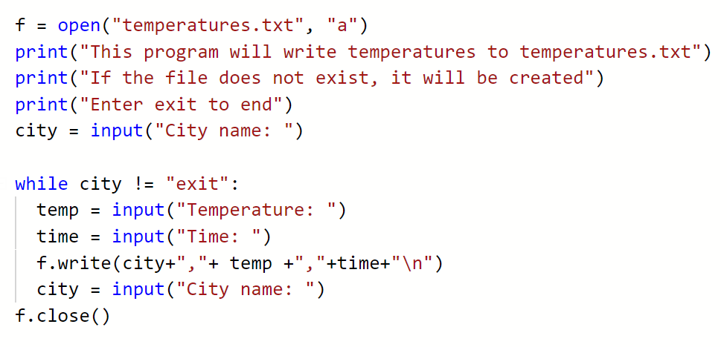

Slide 12
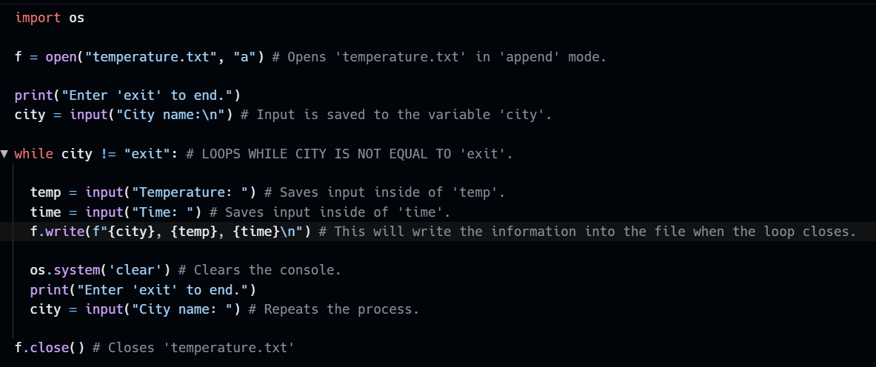
Using f-strings to format the text:
Code by Jake

Slide 13
activity
Allow the user to enter city (or town) name, temperature and time
Append this data to a file
Copy this code
Can you CRUD each record and save the file using the file write command?
Make sure you make use of functions.
5 min
Think pair share
Notes:
Students will have to open the file as write (not append) to update a city.
Or they may wish to read the whole file into a data structure, then make changes to the data, then write it out when the user is finished.

